Slide 1

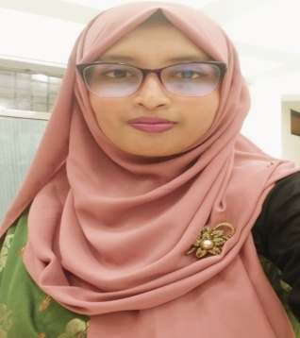

+8801521215048
+8801894536734
afrozasultanatoma23@gmail.com
Afroza Sultana Toma
MST. AFROZA SULTANA TOMA
Bachelor of Business Administration
(Management Studies)
Career Objectives
Education
Work
Experience
To get an opportunity where I can make my best potential and contribute to the organization’s growth.
Secondary School Certificate
Institution
Board
Group
Result
Passing Year
Higher Secondary School Certificate
Institution
Board
Group
Result
Passing Year
Bachelor of Business Administration
Institution
Department
Result
Passing Year
Master of Business Administration
Institution
Department
Result
Session
Three months internship at Prime Bank Limited on general banking.
: Savar Cantonment Board Girl’s High School
: Dhaka
: Humanities
: GPA-5.00(out of scale 5.00)
: 2014
: Savar Cantonment Public School and College
: Dhaka
: Humanities
: GPA-4.67(out of scale 5.00)
: 2016
: Mawlana Bhashani Science and Technology University
: Management Studies
: 3.14(Out of scale 4.00)
: 2021
: Mawlana Bhashani Science and Technology University
: Management
: Appeared
: 2021-2022

Slide 2
Computer Literacy
Microsoft PowerPoint
Microsoft Word
Microsoft Excel
Language Skill
Course & Summit
English- Speaking, reading, writing.
Bengali- Fluent in speaking, reading, writing.
Six months course on computer .
Participated ” Business innovation summit”
Completed Course on “Safer internet For children”.
Personal Qualities
Personal Information
Hardworking
Willingness to learn
Diligent and organized
Punctual
Honest
: Mst.Afroza Sultana Toma
: Md. Anwar Sharif
: Mst. Rashida Parvin
: 23May1998
: South Gazirchat , Ashulia , Savar , Dhaka
: Manikdha , Bhanga , Faridpur
: Bangladeshi
: 6005097164
: 01521215048
01894536734
: O+
Name
Father’s Name
Mother’s Name
Date of Birth
Present Address
Permanent Address
Nationality
National ID Card Number
Mobile Number
Blood Group
Dr, Abdul Gaffar Khan
Associate Professor
Department of Management
Mawlana Bhashani Science and Technology
Mobile: 01722845851
Mridha Shahinoor Rahman
Accounts Officer
Bangladesh Municipal Development Fund
Mobile:01726702778
I, Mst. Afroza Sultana Toma, undersigned, state that the information stated above is true, correct, and clearly understood. Any willful misstatement may lead to disqualification and dismissal.
Signature :
Mst.Afroza Sultana Toma
Reference

Slide 3
